Slide 1
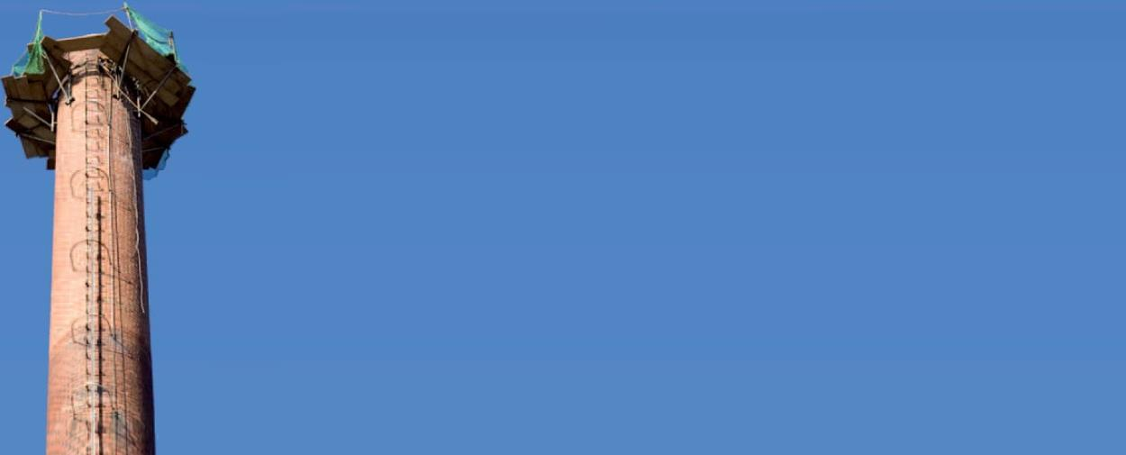
SO2 Emission Control & Reduction
Technical Development Program for Process Performance Engineers – SPREAD 2016
Mirko Weber

Slide 2
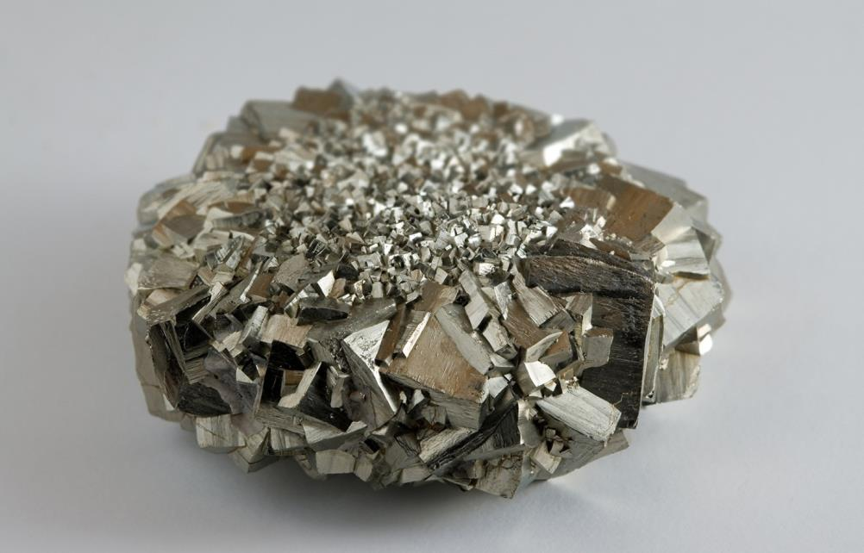
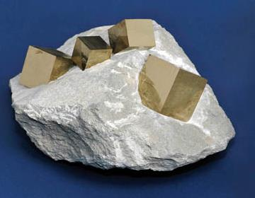
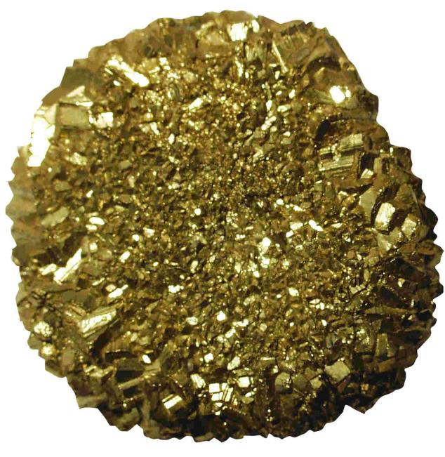
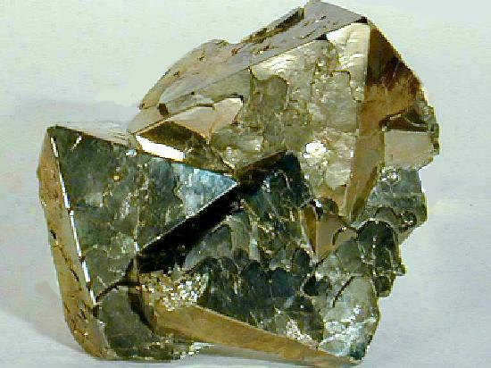
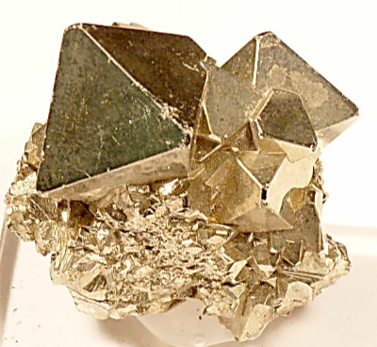
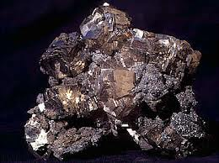
Correct, Pyrite – FeS₂
2

Slide 3
Content
Environmental impact of SO₂
How to analyze/solve a SO₂ emission problem
Formation of SO₂ in kiln system
Primary measures
Secondary measures
3

Slide 4
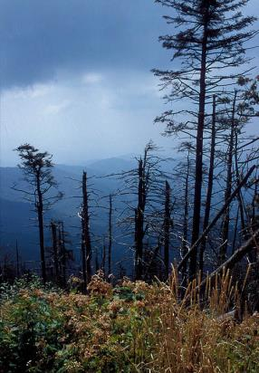
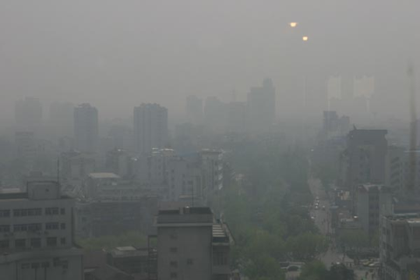
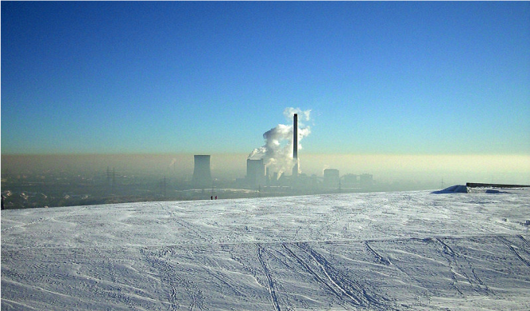
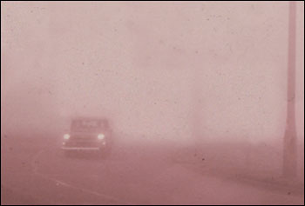
SO₂ contributes to smog and acid rain formation
Smog killed 8’000 people in London in 1952
Acid rain damages vegetation
Smog in large cities nowadays
Inversion situation
4

Slide 5
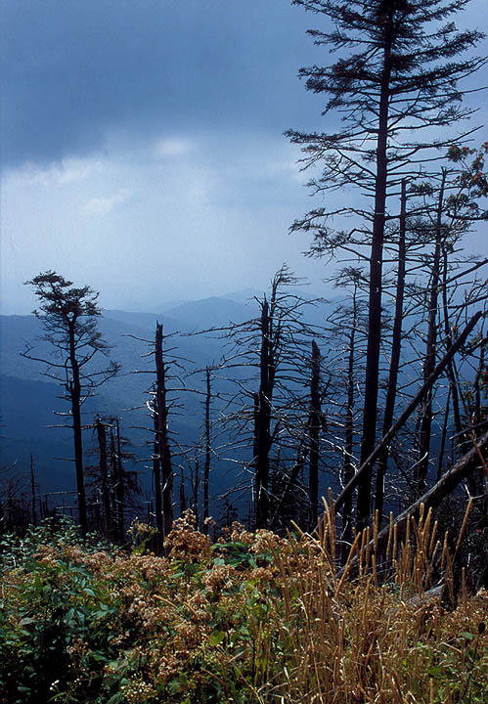

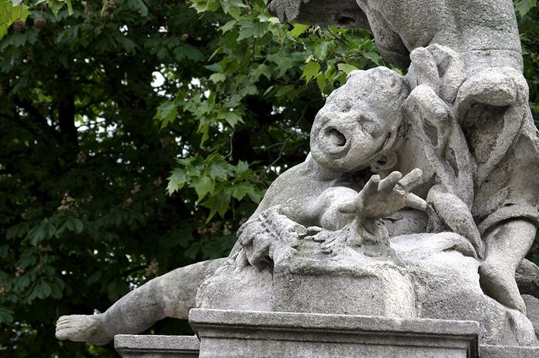

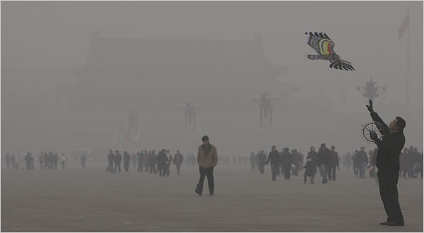

SO₂ contributes to smog and acid rain formation
Smog killed 8’000 people in London in 1952
Inversion situation
5

Slide 6
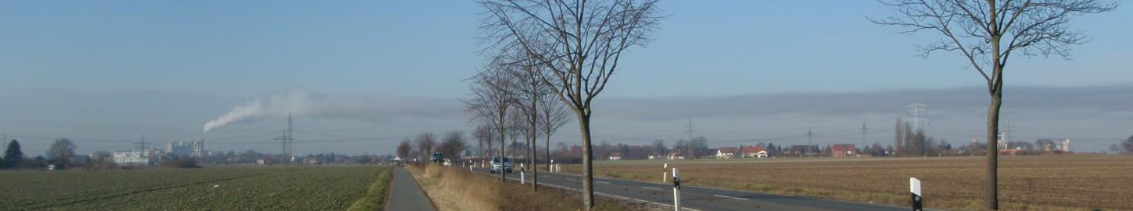
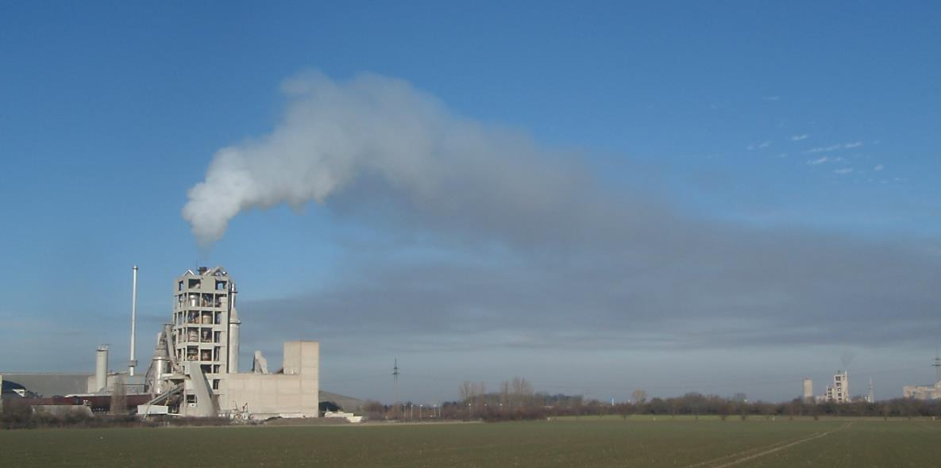
SO₂ can lead to Opacity – Detached plume
Steam plume
Secondary plume
6

Slide 7
Transformation of SO₂ units
Standard reporting in mg/Nm³ dry @ 10% O₂
Conversion: ppm x 2.86 = mg/Nm³
SO₂ Emissions expressed in mg/Nm³ wet*
SO₂ measurement (in ppm)
Wet – dry conversion:
?
SO₂ Emissions expressed in mg/Nm3 dry @ y % O₂
O₂ correction:
SO₂ Emissions expressed in mg/Nm³ dry
* Wet according to measurement principle (in situ, hot extractive, etc) ** Water content of gas (vol %)
7

Slide 8
General procedure for emission abatement
Elimination of precursors
Primary measures
Secondary measures
8

Slide 9
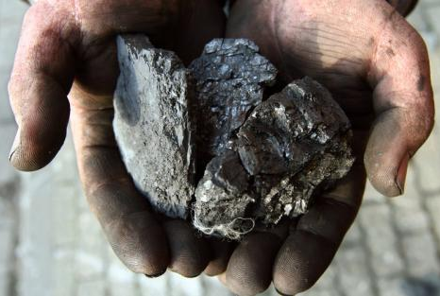
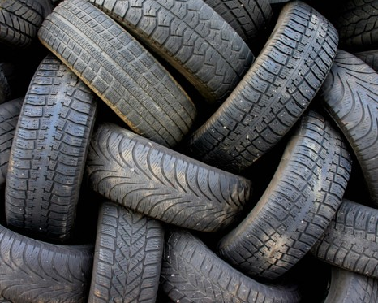
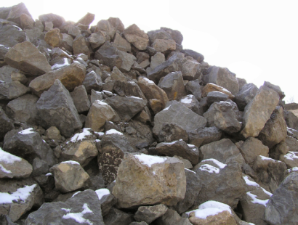
Sulphur input into the kiln system via fuel and raw materials vary
Fuel
Coal: 0.5 - 4.0 % S
Fuel oil: 1.0 - 2.5 % S
Petcoke: 3.0 - 8.0 % S
Tires: 0.8 - 4.0 % S
Raw material:
Variable from < 0.1 % to > 1 % S as SO₃
SO₃ average : ~ 0.45 % SO₃
9

Slide 10
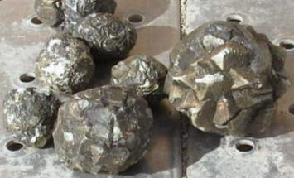
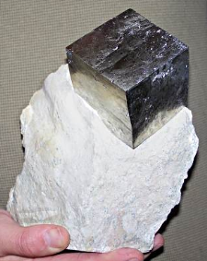

Sulphur input into the kiln system - Compounds in raw material have different volatilities
High volatility
Low volatility
Sulphured organic compounds
Pyrite (FeS₂)
Sulfides (CaS)
Sulphites (CaSO₃)
Sulphates (CaSO₄)
10

Slide 11
SO₂ emissions of preheater kilns are basically fuel independent – exception: SO2 from bypass
Pyrite - Raw material
30 – 80 % forms SO₂
Filter
10-30 % SO₂ Absorption
„100 % SO₂-Barrier“
SO₂ + CaO + ½ O₂ → CaSO₄
S-Fuel (AF or trad.)
100 % forms SO₂
Raw mill
30 – 60 %
SO₂ absorption in compound operation
Sulphate from raw material
30- 80 % forms SO₂
11

Slide 12
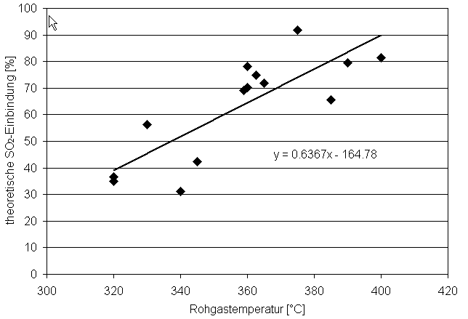
SO₂ emissions from pyrite depend on temperature
Expected pyritic sulfur contribution to SO₂ emissions can be verified
Analysis of all raw meal components
Expulsion test
Theoretical calculation For dry SP kilns e.g. at 370°C, assume 30% of pyrite goes to the emissions in direct operation, ca. 15% in compound operation
70% capture > 30% “emission”
Empirical SO₂ capture in PH tower (%)
370
PH exit gas temperature (°C)
12

Slide 13
SO₂ emissions lower in compound mode
Primary Measure for preheater kilns: Increase mill running time > up to 50% less SO₂ emissions
SO2 absorption in mill and filter - example with high retention rate
13

Slide 14
quench
chamber
discharge to cement
clinker
14

Slide 15
Sulfur from fuel and raw material contributes to SO₂ emissions in long kilns (wet or dry)
Pyrite - Raw material
30 – 50 % forms SO₂
S-Fuel
100 % forms SO_{x}*
Filter dust
10-30 % SO₂ Absorption
*SO_{x} = SO₂ + SO₃
Sulphate - Raw material
30- 80 % forms SO₂
Kiln dust
40-60 % SO₂ Absorption
15

Slide 16
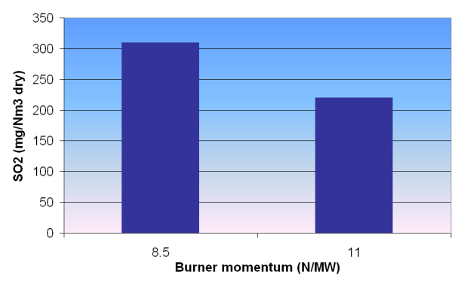
SO2 elimination of precursors & primary measures – optimize combustion in case of long kilns
Dry preheater kilns
Selective quarrying if possible, reduce high volatile S input
Increase mill running time
Recycle bypass gas to cooler (references in legacy Lafarge plants)
Wet/dry long kilns
Reduce S-input via fuels or raw material
Homogenize fuels (in case of SO₂ peaks)
Reduce sulfur volatility
Avoid combustion in reducing conditions , provide excess air (no CO!)
Avoid temperature peaks and over-burning (CaO_{f} 0.8-1.5%)
Avoid long flame, adjust burner momentum (see example)
Assure sulfatization of the alkalis
Burner position parallel to kiln axis
Optimum fuel fineness and dispersion
Stable kiln operation (Kiln Master)
Improve burnability of kiln feed by e.g. reducing the SM
16

Slide 17
Sulphur volatility depends on the oxygen concentration in the kiln (wet/long kilns)
SO₂ at stack in function of kiln O₂ (wet kiln line)
17

Slide 18
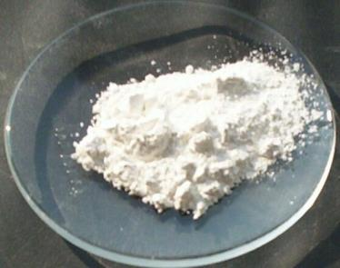
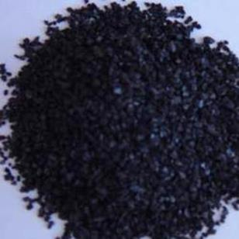
Secondary measures – from dry to wet technology
Dry methods
Addition of Ca(OH)₂, Na₂CO₃, activated coal, spongiacal lime (high specific surface)
Polvitec (activated coke filter)
Semi-dry, Semi-wet methods
Injection of hydrated lime slurry (into the conditioning tower)
Wet technologies
Wet scrubber
18

Slide 19
Addition of dry lime for SO2 abatement
Efficiency of dry Ca(OH)2 is influenced by temperature
Needs 350°C and more
Aqueous
phase
(wet)
Gas phase reaction
(dry)
19

Slide 20
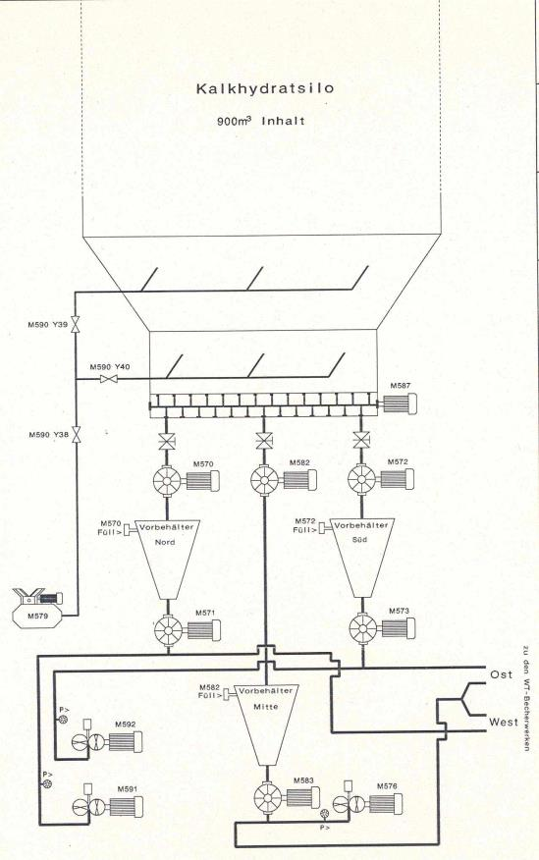
Addition of dry lime for SO₂ abatement, Höver (Germany)
Tests with addition in front of filter or in conditioning tower showed low efficiency
Best practice: addition of dry lime to the kiln feed
Dosing via rotary valves
Jet transport of lime to bottom of bucket elevator
Approx. 950 kg/h lime
Control of addition in function of SO₂ at stack
Reduction from max 1’300 to below 400 mg/Nm³ (kiln prod: 2’600 t/d)
20

Slide 21
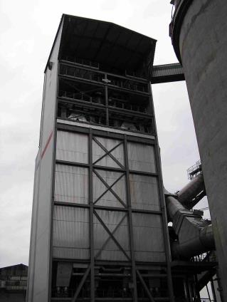
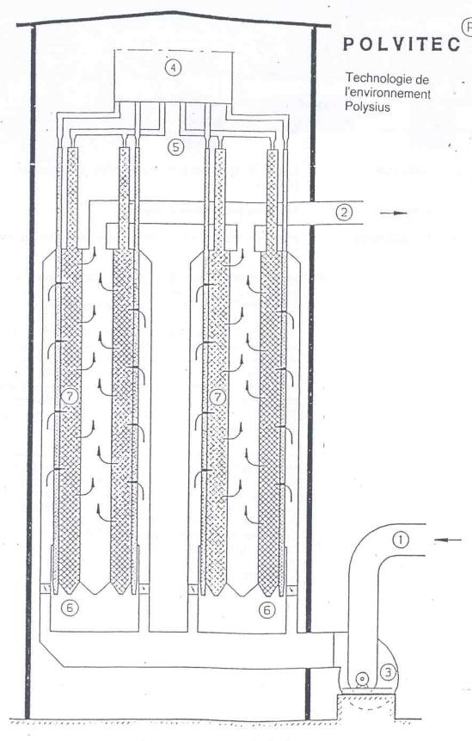
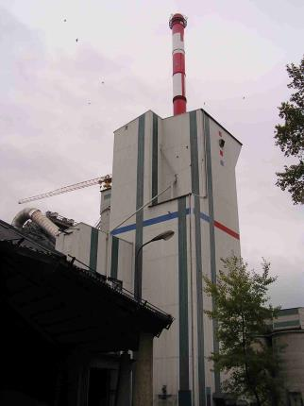
Activated coke filter “Polvitec” in Siggenthal (Switzerland)
Investment 30 Mio CHF
Reduction from max.1’500 to 7 mg/Nm³
Activated coke: 2’600 tpy
Costs 400 CHF/t coke
Eliminates as well NH₃, VOC, Hg, etc.
Operating costs ca. 5 CHF/t_{cli} (1.5 CHF/t cli for coke)
21

Slide 22
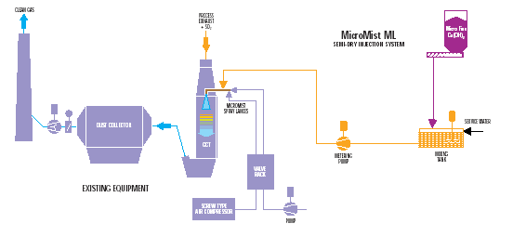
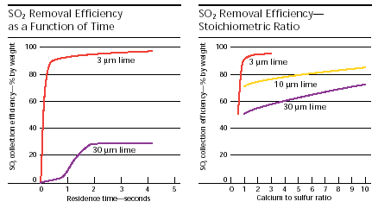
Injection of “micromist” into the cooling tower
Aqueous
phase
(wet)
Gas phase reaction
(dry)
22

Slide 23
Injection of “micromist” into the cooling tower, example
Example:
Gas flow 350’000 Nm3/h
Guarantee: 90% SO₂ reduction, 94% HCl reduction
Investment costs approx. 1- 1.5 Mio USD
High operating costs in case of permanent operation (lime costs 93 USD/t)
Sulfur goes back to kiln (circulation phenomena)
23

Slide 24
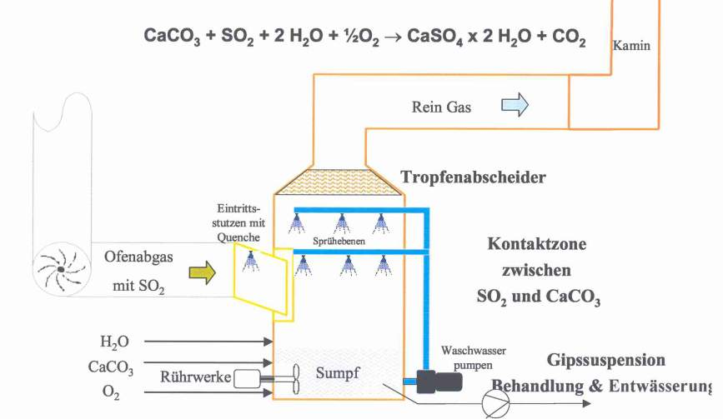
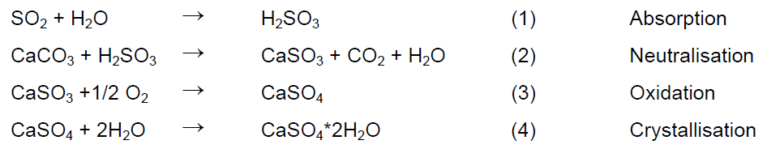
Wet limestone scrubber technology is the ultimate measure
CaCO₃ + SO₂ + 2 H₂O + ½ O₂ → CaSO₄ x 2 H₂O + CO₂
CaCO₃ + SO₂ + 2 H₂O + ½ O₂ → CaSO₄ x 2 H₂O + CO₂
Stack
Clean gas
Mist separator
Inlet with quench
Contact zone between SO₂ and CaCO₃
Raw gas with SO₂
Recircul. pumps
Absorber sump
Treatment and dewatering of gypsum suspension
Mixer
24

Slide 25

Wet limestone scrubber technology
Stack
Clean gas
Mist eliminators
Inlet with quench
Contact zone between SO₂ and CaCO₃
Raw gas with SO₂
Recircul. pumps
Absorber sump
Treatment and dewatering of gypsum suspension
Mixer
25

Slide 26
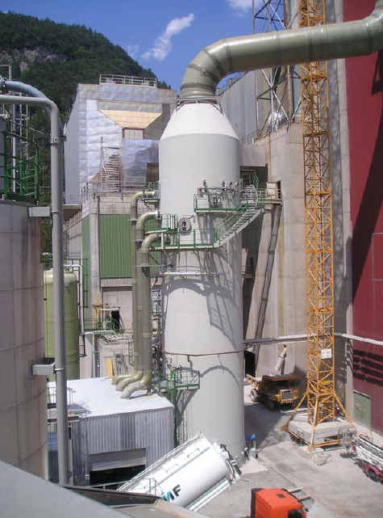
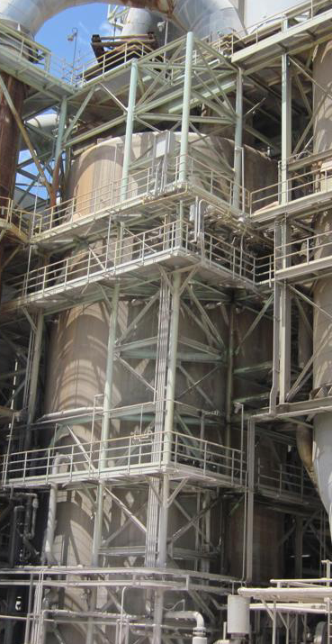
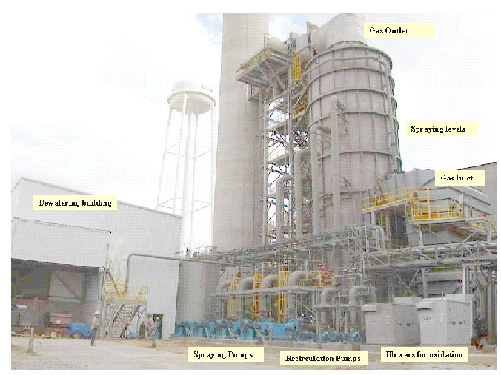
Wet scrubbers in Legacy Holcim
Untervaz, CH
Portland, US
Midlothian, US
26

Slide 27
Gypsum for finish products is produced by scrubber system
Absorber tower incl.
Redundant gas quench at the scrubber inlet
3 nozzle stages
Mist eliminator (chevron type 3 layers)
Stack (fixed to the preheater tower)
Pumps for circulating the slurry (e.g. 3)
Gypsum dewatering (hydrocyclone, settling tank, centrifuge and weighing belt. Flocculant generally not required)
Silos for reagent
Emergency tank (for emptying scrubber or buffering gypsum slurry) (e.g. 150 m3)
Bleed stream
old / new stack
Scrubber
Gypsum conditioning
H₂O
Flocculant
Kiln gas
H₂O
Lime- stone & Dust
H₂O
H₂O
air
Reagents conditioning
Gypsum dosage
27

Slide 28
Schematic process flow sheet for wet scrubber
Scrubber
Gypsum conditioning
old / new stack
H₂O
Flocculant
Kiln gas
H₂O
Lime- stone & Dust
H₂O
H₂O
air
Reagents conditioning
Gypsum dosage
28

Slide 29
Key Issues – Critical points to be controlled
Quenching of raw gas at scrubber inlet to 55°C in order to protect lining of scrubber (PP)
High density of absorber sump that could damage scrubber components (controlled by bleed stream)
Bleed stream is mandatory in order to eliminate inerts (SiO2, etc) that would affect negatively the gypsum quality (size and hence dewatering)
pH of sump has to be kept at around 5
Gypsum conditioning
29

Slide 30
Mandatory bleed stream in wet scrubbers
Bleed stream in order to eliminate inerts (SiO₂, etc) that would affect negatively the gypsum quality
Water
Flocculant
Wet
Scrubber
Hydro- cyclone
Settling Tank
Waste water Bleed stream
Centrifuge
Gypsum
30

Slide 31
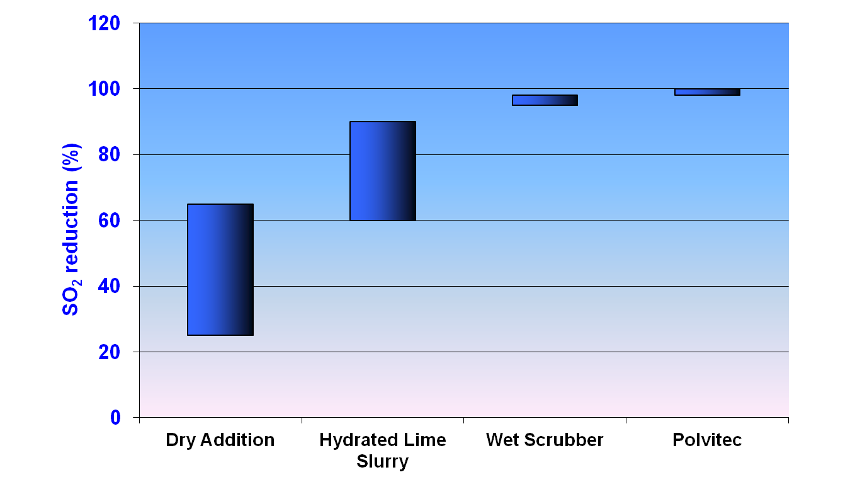
Efficiency of different secondary measures
30
25
20
15
CAPEX (Mio USD)
10
5
0
31

Slide 32
Summary
SO2 emissions depend on
Type of kiln system SO2 emissions of preheater kilns are basically fuel independent – exception: SO2 from bypass (and unfavorable conditions in tower)
Sulphur input by raw materials (high volatiles) / fuel (long kiln)
Kiln operating conditions (volatility, bypass)
Secondary reduction measures
Actual and future SO2 limits ➔ secondary reduction necessary in many cases
Available technology allows SO2 reduction up to...
...60 % by dry hydrated lime addition
...75 % by semi-wet scrubbing systems
...98 % by wet scrubbers
32

Slide 33
Questions/Remarks?
33

